Slide 1
Dark Matter
&
The Unseen Worlds:
A Hypothetical exploration
bridging science & eschatology
By
Walter P. Benesch

Slide 2
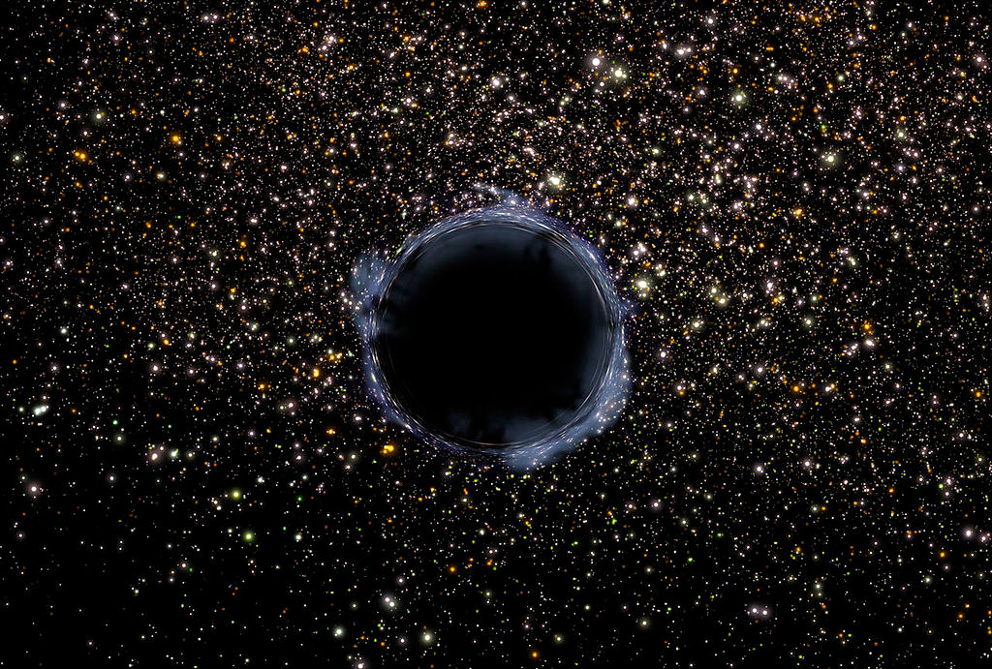
Dark Matter &
Particle Physics
Is the science leading to understandings of
The possibility of other worlds?
In other dimensions?
In a parallel existences?
Implications for
Possible existence of a spiritual realm
Validation of Masonic teachings
Primary Source: Lisa Randall: Dark Matter and the Dinosaurs

Slide 3
I don’t have answers
Only theories
Using the latest science

Slide 4
What is Dark Matter?
Dark Energy/Matter is the Unseen Universe
85% of Universe’s Matter (matter / energy)
Detected through gravity
Manifested in magnetic pull of light, energy, & objects
15% is Ordinary Matter
Stars
Gasses
People, places, & things

Slide 5
Dark Matter
One theoretical variation

Slide 6
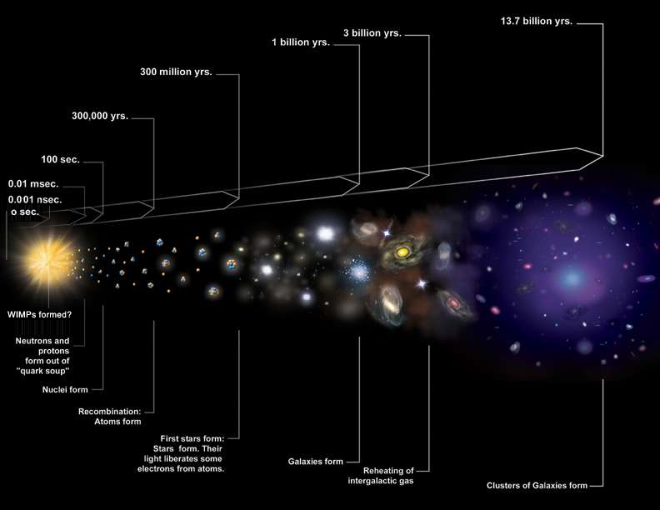
Universe’s Formation
Dark matter is where
clouds & solar system are not maybe even more places

Slide 7
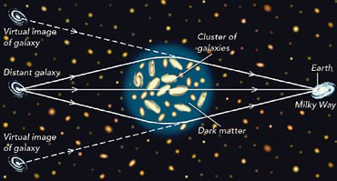
How Detected?
Indirectly - curvature of light

Slide 8
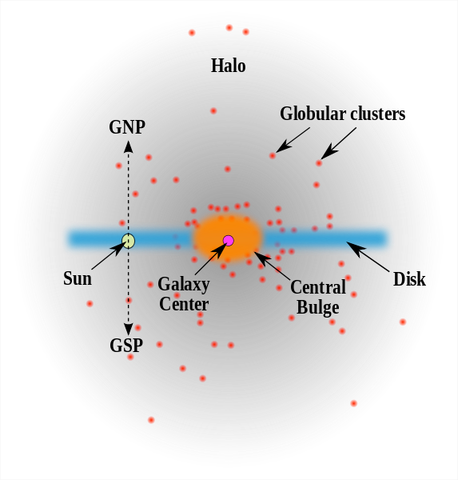
In the Milky Way
All around
Clusters concentrated
Most in center
Around disk
Has variable density
Greatest in disk
With our Sun
Black
hole
.

Slide 9
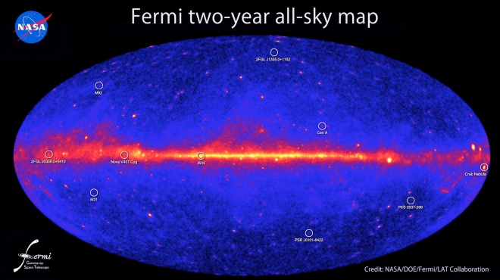
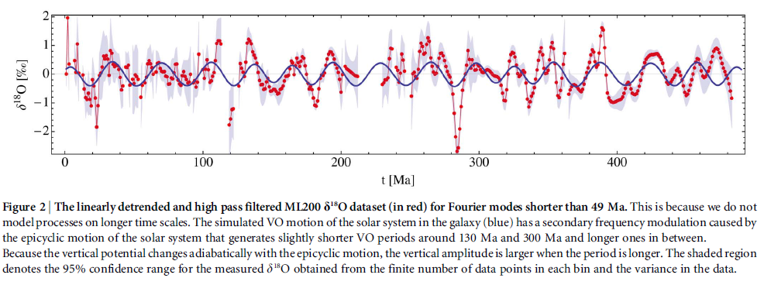
Concentrated Waves
Varying levels of high energy most likely caused by existing of Dark Energy & Dark Matter

Slide 10
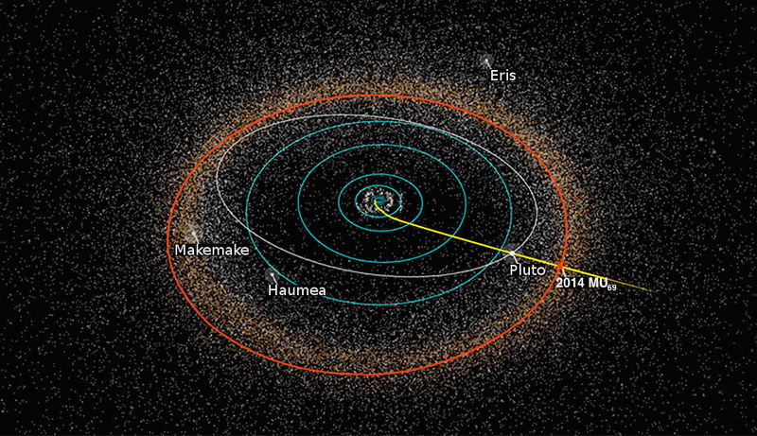
Our Solar System
Passes through the waves
Dark matter is scattered throughout, especially in Oort Cloud
But varies in depth & pull
Kuiper belt
As it travels around the Milky Way
Oort Cloud

Slide 11
Imfluence on Earth
As Sun passes through high concentrations in the Milky Way
Oort Cloud Dark Matter strong gravity
Kuiper Belt objects
Pulled pulled out of orbit towards sun
Created periodic impacts on Earth
Direct result of Dark Matter’s pull (mass)
Example: Astroid that killed the dinosaurs
One of many impacts on Earth

Slide 12
Dark Matter on Earth
Matter an invisible world ? ! ! ! ?
Could be a mirror image of physical
Asymmetric construct
Detection only indirect
Particles at different vibrations!?!
If it is unseen world(s?)! …
Could there be Multiple levels?
Implications??

Slide 13
Worlds?
Invisible to human eye
Could this dark matter contain other realities?
Vibrating at a different rate?
Those are the theories
What are the implications

Slide 15
IMPLICATIONS
Possible existence of other worlds ? ! ?
Co-existing with our own
What the ancients called:
Astral
Psychical
Spiritual
Divine

Slide 16
Star Teck Clues/
“Wink of an Eye” - original show, 3rd season
A race of beings who move through the Enterprise at a rate so fast that they're all but undetectable.
Clever use of tilted camera angles & lighting help to sell the illusion of the characters moving about the ship at their hyper-accelerated rate.
Remember Sci-Fy has led to dramatic discoveries in the past
Could this hold a key to the dark matter world?
Might science find ways to see these other worlds?

Slide 17
Or Do We Already Know them?
Divine
Ancients Myths
Kabbalah’s Ladder
Shamans trances
Visions of upper &
:Lower worlds
In this tradition would be the astral
Spiritual
Astral
Physical
The Worlds of Jacob's Ladder

Slide 18
Overlapping Existences
Divine 20%?
Spiritual 30%?
Astral / Psychic 35%?
Physical about 15%
Kabbalah’s
Worlds?

Slide 19
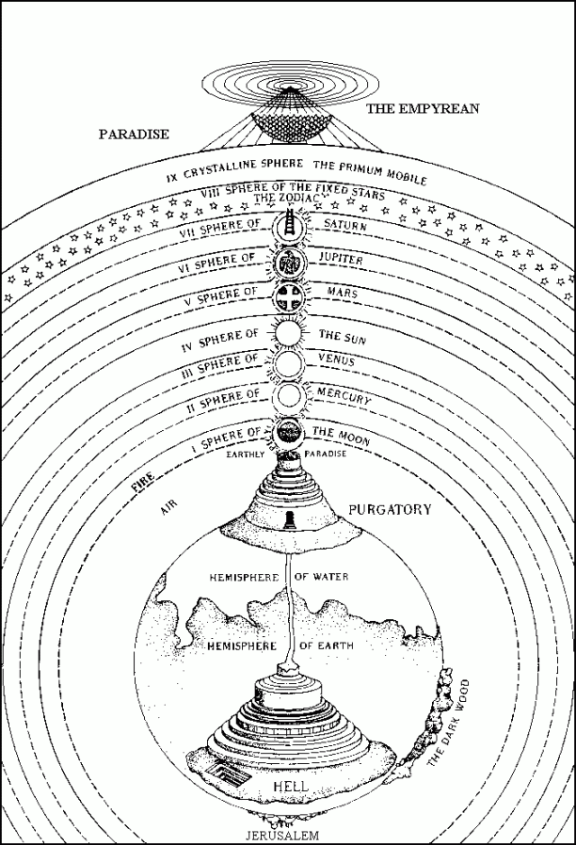
Science Closer to Spirituality?
The unseen worlds
Seen elsewhere
Dante
Under Worlds
Purgatory &
Hell
Upper World (Paradise)
Physical world between
Dante’s worlds

Slide 20
Science Closer to Mythology?
Seen elsewhere
Tibetan Tara Myth
9 levels
Up &
Down
Similar to Shamanism’s
upper &
lower worlds
Dante’s worlds
= Hermetic
As above
So Below?

Slide 21
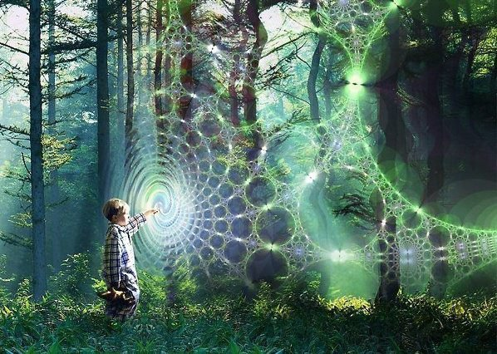
Science Closer to seeing Astral?
Dante’s worlds
Found in Scotland
At Findhorn
On this plane!
Fairies
Other mythical creatures
Communication daily experience there
Other beings on other planes working with community

Slide 22
Science Closer to Spirituality?
Science may help
Astrophysics may tell us in the future
Dark Matter
Could it be the realm of spiritual light?could really be the world of LIGHT?
Dante’s worlds

Slide 23
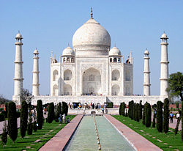
Masonic Teachings
Would be affirmed!
If so then
Grand Lodge Eternal
Really Exists?!?

Slide 24
Questions ? ? ?
Comments ! ! !
q

